Slide 1



Methodology of Problem Solving
Efficiently Solving Computer Programming Problems
Problem Solving
SoftUni Team
Technical Trainers
Software University
http://softuni.bg
Notes:
© Software University Foundation – http://softuni.org
This work is licensed under the Creative Commons Attribution-NonCommercial-ShareAlike license.
<number>

Slide 2

Table of Contents
<number>
Notes:
© Software University Foundation – http://softuni.org
This work is licensed under the Creative Commons Attribution-NonCommercial-ShareAlike license.
<number>

Slide 3



Problems Solving
From Chaotic to Methodological Approach

Slide 4
Read and Analyze the Problems
Consider you are at a computer programming exam or contest
You have 5 problems to solve in 6 hours
First read carefully all problems and try to estimate how complex each of them is
Read the requirements, don't invent them!
Start solving the easiest / fastest to solve problem first!
Leave the most complex / slow to solve problem last!
Approach the next problem when the previous is well tested
<number>

Slide 5
Analyzing the Problems
Example: we are given 3 problems:
Cards Shuffle
Shuffle a deck of 52 cards in random order
Zig-Zag Matrix
Find the max-sum zig-zag path in a matrix
Start from the first column, go up, then down, then again up, them again down, …
Blocks
Generate all blocks 2 x 2 holding 4 of the first n Latin letters
4

Slide 6
Analyzing the Problems (2)
Read carefully the problem descriptions
Think a bit about their possible solutions
Order the problems from the easiest to the most complex:
Cards Shuffle
Trivial – randomize the elements of array
Blocks
Generate variations, rotate and check for duplicates
Zig-Zag Matrix
Needs summing, sorting and text file processing
5

Slide 7


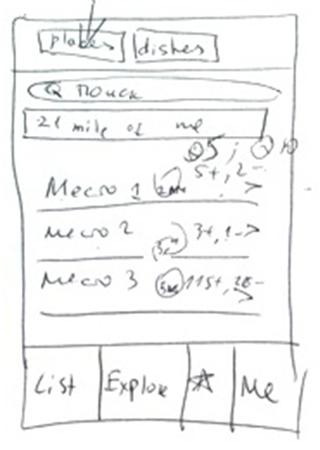

Using a Paper and a Pen
Visualizing and Sketching your Ideas

Slide 8

Use a Sheet of Paper and a Pen
Never start solving a problem without a sheet of paper + a pen
You need to sketch your ideas
Paper and pen is the best visualization tool
Allows your brain to think efficiently
Paper works faster than keyboard / screen
Other visualization tools could also work well
<number>

Slide 9
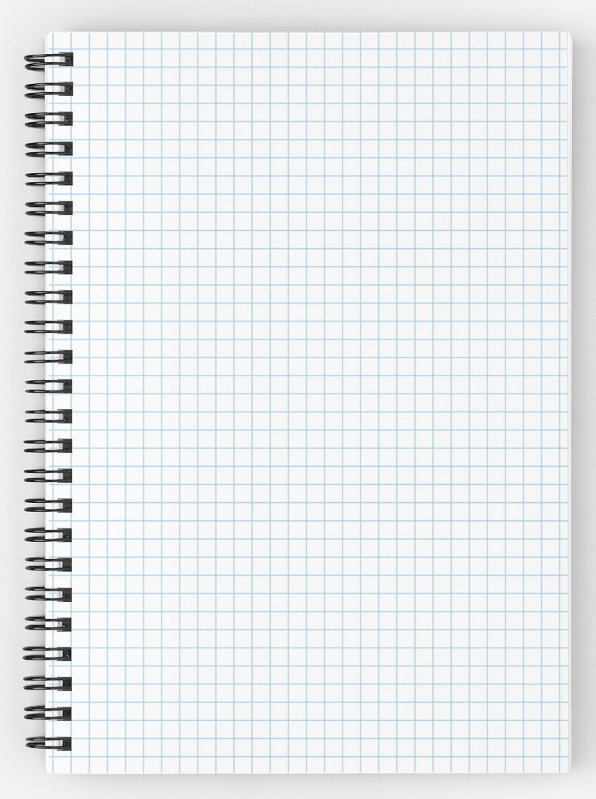
Prefer Squared Paper
Squared paper works best for algorithmic problems
Easy to draw a table
Easy to draw a coordinate system with objects at it
Easy to calculate distances
Easy to sketch a problem and solution idea
<number>

Slide 10
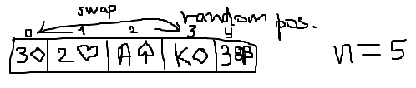
Paper and Pen
Consider the "Cards Shuffle" problem
We can sketch it to start thinking
Some ideas immediately come, e.g.
Split the deck into two parts and swap them a multiple times
Swap 2 random cards a random number of times
Swap each card with a random card
<number>

Slide 11

Invent Ideas
Think-up, Invent Ideas and Check Them

Slide 12
Think Up, Invent and Try Ideas
First take an example of the problem
Sketch it on the sheet of paper
Next try to invent some idea that works for your example
Check if your idea will work for other examples
Try to find a case that breaks your idea
Try challenging examples and unusual cases
If you find your idea incorrect, try to fix it
Or just invent a new idea
<number>

Slide 13
Invent and Try Ideas – Example
Consider the "cards shuffle" problem
Idea #1: random number of times split the deck into left and right part and swap them
How to represent the cards?
How to chose a random split point?
How to perform the exchange?
Idea #2: swap each card with a random card
How many times to repeat this?
Is this fast enough?
<number>

Slide 14
Invent and Try Ideas – Example (2)
Idea #3: swap 2 random cards a random number of times
How to choose two random cards?
How many times to repeat this?
Idea #4: choose a random card and insert it in front of the deck
How to choose random card?
How many times to repeat this?
Idea #5: do you have another idea?
13

Slide 15
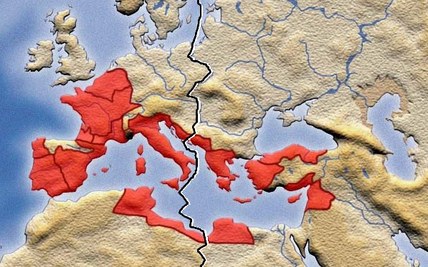
Divide and Conquer
Decompose Problems into Manageable Pieces

Slide 16
Decompose the Problem
Work decomposition is natural in engineering
It happens every day in the industry
Projects are decomposed into subprojects
Complex problems could be decomposed into several smaller sub-problems
Technique known as "Divide and Conquer"
Small problems could easily be solved
Smaller sub-problems could be further decomposed as well
<number>

Slide 17
Divide and Conquer – Example
Let's try idea #1:
Split the deck into left and right part and swap them (many times)
Divide and conquer
Sub-problem #1 (single exchange) – split the deck into two random parts and exchange them
Sub-problem #2 – choosing a random split point
Sub-problem #3 – combining single exchanges
How many times to perform "single exchange"?
16

Slide 18
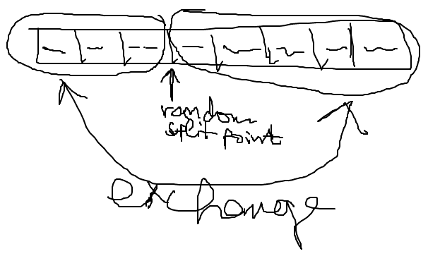
Sub-Problem #1 (Single Exchange)
Split the deck into two parts at random split point
And exchange these 2 parts
We visualize this by paper and pen:
17

Slide 19
Sub-Problem #1 (Single Exchange)
Choosing a random split point
Need to understand the concept of pseudo-random numbers and how to use it
In Internet lots of examples are available, some of them incorrect
The class System.Random can do the job
Important detail is that the Random class should be instantiated only once
Not at each random number generation
17

Slide 20
Sub-Problem #1 (Single Exchange)
Combining a sequence of single exchanges to solve the initial problem
How many times to perform single exchanges to reliably randomize the deck?
N times (where N is the number of the cards) seems enough
We have an algorithm:
N times split at random position and exchange the left and right parts of the deck
17

Slide 21

Check-up Your Ideas
Don't go Ahead before Checking Your Ideas

Slide 22
Check-up Your Ideas
Check-up your ideas with examples
It is better to find a problem before the idea is implemented
When the code is written, changing your ideas radically costs a lot of time and effort
Carefully select examples for check-up
Examples should be simple enough to be checked by hand in a minute
Examples should be complex enough to cover the most general case, not just an isolated case
<number>

Slide 23
Check-up Your Ideas – Example
Let's check the idea:
After 3 random splits and swaps we obtain the start position
Seems like a serious problem!
<number>

Slide 24
Invent New Idea If Needed
What to do when you find your idea is not working in all cases?
Try to fix your idea
Sometimes a small change could fix the problem
Invent new idea and carefully check it
Iterate
Usually your first idea is not the best
Invent ideas, check them, try various cases, find problems, fix them, invent better ideas, etc.
23

Slide 25
Invent New Ideas – Example
Invent a few new ideas:
New idea #1 – multiple times select 2 random cards and exchange them
New idea #2 – multiple times select a random card and exchange it with the first card
New idea #3 – multiple times select a random card and move it to an external list
Let's check the new idea #2
Is it correct?
<number>

Slide 26
Check-up the New Idea – Example
The result seems correct
<number>

Slide 27

Think about Data Structures
Select Data Structures that Will Work Well

Slide 28
Choosing Appropriate Data Structures
Choose appropriate data structures before you start coding
Think how to represent input data
Think how to represent intermediate program states
Think how to represent the requested output
You could find that your idea cannot be implemented efficiently
Or implementation will be very complex or inefficient
<number>

Slide 29
Choose Appropriate Data Structures – Example
How to represent a single card?
The best idea is to create a structure / class Card
Face – could be string, int or enumeration
Suit – enumeration
How to represent a deck of cards?
Array – Card[]
Indexed list – List<Card>
Set / Dictionary / Queue / Stack – not a fit
<number>

Slide 30

Efficiency and Performance
Is Your Algorithm Fast Enough?

Slide 31
Think About the Efficiency
Think about efficiency before writing the first line of code
Estimate the running time (asymptotic complexity)
Check the requirements
Will your algorithm be fast enough to conform with them?
You don't want to implement your algorithm and find that it is slow when testing
You will lose time
<number>

Slide 32
Efficiency is not Always Required
Best solution is sometimes just not needed
Read carefully your problem statement
Sometimes ugly solutions could work for your requirements and it will cost you less time
Example: if you need to sort n numbers, any algorithm will work well for n ∈ [0..500]
Implement complex algorithms only when the problem really needs them
<number>

Slide 33
Efficiency – Example
How many cards do we have?
In a typical deck we have 52 cards
No matter how fast the algorithm is – it will work fast enough
If we have N cards, we perform N swaps → the expected running time is O(N)
O(N) will work fast for millions of cards
Conclusion:
The efficiency is not an issue in this problem
<number>

Slide 34

Implementation
Coding and Testing Step-by-Step

Slide 35
Start Coding: Check List
Never start coding before you find a correct idea that will meet the requirements
What shall you write before you have a correct idea?
Checklist to follow before start of coding:
Ensure you understand the requirements well
Ensure you have come up a good idea
Ensure your idea is correct
Ensure you know what data structures to use
Ensure the performance will be sufficient
<number>

Slide 36
Coding Check List – Example
Checklist before you start coding:
Ensure you understand the requirements well
Yes, shuffle a given deck of cards
Ensure you have come up with a correct idea
Yes, the idea seems correct and is tested
Ensure you know what data structures to use
Class Card, enumeration Suit and List<Card>
Ensure the performance will be sufficient
Linear running time → good performance
<number>

Slide 37
Implement your Algorithm Step-by-Step
"Step-by-step" approach is always better than "build all, then test"
Implement a piece of your program and test it
Then implement another piece of the program and test it
Finally put together all pieces and test it
Small increments (steps) reveal errors early
"Big bang" integration takes more time
<number>

Slide 38
Step #1 – Class Card
class Card
{
public string Face { get; set; }
public Suit Suit { get; set; }
public override string ToString()
{
string card = "(" + this.Face + " " + this.Suit +")";
return card;
}
}
enum Suit
{
Club, Diamond, Heart, Spade
}
<number>

Slide 39
Step #1 – Test
Testing the class Card to get feedback as early as possible:
The result is as expected:
static void Main()
{
Card card = new Card() { Face="A", Suit=Suit.Club };
Console.WriteLine(card);
}
(A Club)
<number>

Slide 40
Step #2 – Create and Print a Deck of Cards
static void Main()
{
var cards = new List<Card>();
cards.Add(new Card() { Face = "7", Suit = Suit.Heart });
cards.Add(new Card() { Face = "A", Suit = Suit.Spade });
cards.Add(new Card() { Face = "10", Suit = Suit.Diamond });
cards.Add(new Card() { Face = "2", Suit = Suit.Club });
cards.Add(new Card() { Face = "6", Suit = Suit.Diamond });
cards.Add(new Card() { Face = "J", Suit = Suit.Club });
PrintCards(cards);
}
static void PrintCards(List<Card> cards)
{
foreach (Card card in cards) Console.Write(card);
Console.WriteLine();
}
<number>

Slide 41
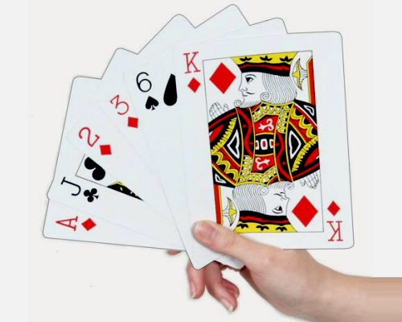
Step #2 – Test
Testing the deck of cards seems to be working correctly:
(7 Heart)(A Spade)(10 Diamond)(2 Club)(6 Diamond)(J Club)
<number>

Slide 42
Step #3 – Single Exchange
static void PerformSingleExchange(List<Card> cards)
{
Random rand = new Random();
int randomIndex = rand.Next(1, cards.Count - 1);
Card firstCard = cards[1];
Card randomCard = cards[randomIndex];
cards[1] = randomCard;
cards[randomIndex] = firstCard;
}
<number>

Slide 43
Step #3 – Test
To test the single exchange we use the following code:
The result is unexpected:
static void Main()
{
List<Card> cards = new List<Card>();
cards.Add(new Card() { Face = "2", Suit = Suit.Club });
cards.Add(new Card() { Face = "3", Suit = Suit.Heart });
cards.Add(new Card() { Face = "4", Suit = Suit.Spade });
PerformSingleExchange(cards);
PrintCards(cards);
}
(2 Club)(3 Heart)(4 Spade)
<number>

Slide 44
Step #3 – Fix Bug and Test
The first element of the list is at index 0, not 1:
The result is again incorrect (3 times the same):
static void PerformSingleExchange(List<Card> cards)
{
Random rand = new Random();
int randomIndex = rand.Next(1, cards.Count - 1);
Card firstCard = cards[0];
Card randomCard = cards[randomIndex];
cards[0] = randomCard;
cards[randomIndex] = firstCard;
}
(3 Heart)(2 Club)(4 Spade)
(3 Heart)(2 Club)(4 Spade)
(3 Heart)(2 Club)(4 Spade)
<number>

Slide 45
Step #3 – Fix Again and Test
Random.Next() has exclusive end range:
The result now seems correct:
static void PerformSingleExchange(List<Card> cards)
{
Random rand = new Random();
int randomIndex = rand.Next(1, cards.Count);
Card firstCard = cards[0];
Card randomCard = cards[randomIndex];
cards[0] = randomCard;
cards[randomIndex] = firstCard;
}
(3 Heart)(2 Club)(4 Spade)
(4 Spade)(3 Heart)(2 Club)
(4 Spade)(3 Heart)(2 Club)
<number>

Slide 46
Step #4 – Shuffle the Deck
Shuffle the entire deck of cards:
The result is surprisingly incorrect:
static void ShuffleCards(List<Card> cards)
{
for (int i = 1; i <= cards.Count; i++)
{
PerformSingleExchange(cards);
}
}
Initial deck: (7 Heart)(A Spade)(10 Diamond)(2 Club)(6 Diamond)(J Club)
After shuffle: (7 Heart)(A Spade)(10 Diamond)(2 Club)(6 Diamond)(J Club)
<number>

Slide 47
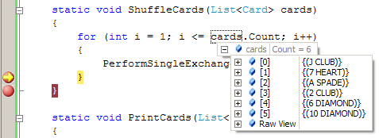
Step #4 – Strange Bug
When we step through the code with the debugger, the result seems correct:
Without the debugger the result is wrong!
Initial deck: (7 Heart)(A Spade)(10 Diamond)(2 Club)(6 Diamond)(J Club)
After shuffle: (10 Diamond)(7 Heart)(A Spade)(J Club)(2 Club)(6 Diamond)
<number>

Slide 48
Step #4 – Fix Again and Test
Random should be instantiated only once:
The result finally is correct with and without the debugger
private static Random rand = new Random();
static void PerformSingleExchange(List<Card> cards)
{
int randomIndex = rand.Next(1, cards.Count);
Card firstCard = cards[0];
Card randomCard = cards[randomIndex];
cards[0] = randomCard;
cards[randomIndex] = firstCard;
}
<number>

Slide 49

Testing the Code
Thoroughly Test Your Solution

Slide 50
Thoroughly Test your Solution
Wise software engineers say that:
Inventing a good idea and implementing it is half of the solution
Testing is the second half of the solution
Always test thoroughly your solution
Invest in testing!
One 90-100% solved problem could be better than 2 or 3 partially solved
Testing an existing problem takes less time than solving another problem from scratch
<number>

Slide 51
How to Test?
Testing could not certify absence of defects
It just reduces the defects’ rates
Well tested solutions are more likely to be correct
Start testing with a good representative of the general case
Not a small isolated case
A typical case
Large enough test case, but
Small enough to be easily checkable
<number>

Slide 52
How to Test? (2)
Test the border cases
E.g. if n ∈ [0..500] → try n=0, n=1, n=2, n=499, n=500
If a bug is found
Repeat all tests after fixing it to avoid regressions
Run a performance test
How to be sure that your algorithm is fast enough to meet the requirements?
Use copy-pasting to generate large test data
<number>

Slide 53
Read the Problem Statement
Read carefully the problem statement
Does your solution print exactly what is expected?
Does your output follow the requested format?
Did you remove your debug printouts?
Be sure to solve the requested problem, not the problem you think is requested!
Example: "Write a program to print the number of permutations of n elements" means to print a single number, not a set of permutations!
<number>

Slide 54
Testing – Example
Test with full deck of 52 cards
Serious error found → change the algorithm
Change the algorithm
Exchange the first card with a random card → exchange cards 0, 1, …, N-1 with a random card
Test whether the new algorithm works
Test with 1 card, 2 cards, 0 cards, 52 cards
Performance test with 52 000 cards
<number>

Slide 55
Test with 52 Cards – Example
static void TestShuffle52Cards()
{
List<Card> cards = new List<Card>();
string[] allFaces = new string[] { "2", "3", "4", "5", "6", "7", "8", "9", "10", "J", "Q", "K", "A" };
Suit[] allSuits = new Suit[] { Suit.Club, Suit.Diamond, Suit.Heart, Suit.Spade };
foreach (var face in allFaces)
foreach (var suit in allSuits)
{
Card card = new Card() { Face = face, Suit = suit };
cards.Add(card);
}
ShuffleCards(cards);
PrintCards(cards);
}
<number>

Slide 56
Test with 52 Cards – Example (2)
The result is surprising:
Half of the cards keep their initial positions!
Serious problem: the randomization algorithm is not reliable
(4 Diamond)(2 Diamond)(6 Heart)(2 Spade)(A Spade)(7 Spade)(3 Diamond)(3 Spade)(4 Spade)(4 Heart)(6 Club)(K Heart)(5 Club)(5 Diamond)(5 Heart)(A Heart)(9 Club)(10 Club)(A Club)(6 Spade)(7 Club)(7 Diamond)(3 Club)(9 Heart)(8 Club)(3 Heart)(9 Spade)(4 Club)(8 Heart)(9 Diamond)(5 Spade)(8 Diamond)(J Heart)(10 Diamond)(10 Heart)(10 Spade)(Q Heart)(2 Club)(J Club)(J Spade)(Q Club)(7 Heart)(2 Heart)(Q Spade)(K Club)(J Diamond)(6 Diamond)(K Spade)(8 Spade)(A Diamond)(Q Diamond)(K Diamond)
<number>

Slide 57
Fixing the Algorithm
New idea that slightly changes the algorithm:
Exchange the first card with a random card → exchange cards 0, 1, …, N-1 with a random card
static void PerformSingleExchange(List<Card> cards, int index)
{
int randomIndex = rand.Next(1, cards.Count);
Card firstCard = cards[index];
cards[index] = cards[randomIndex];
cards[randomIndex] = firstCard;
}
static void ShuffleCards(List<Card> cards)
{
for (int i = 0; i < cards.Count; i++)
PerformSingleExchange(cards, i);
}
<number>

Slide 58
Test with 52 Cards (Again)
The result now seems correct:
Cards are completely randomized
(9 Heart)(5 Club)(3 Club)(7 Spade)(6 Club)(5 Spade)(6 Heart) (4 Club)(10 Club)(3 Spade)(K Diamond)(10 Heart)(8 Club)(A Club)(J Diamond)(K Spade)(9 Spade)(7 Club)(10 Diamond)(9 Diamond)(8 Heart)(6 Diamond)(8 Spade)(5 Diamond)(4 Heart) (10 Spade)(J Club)(Q Spade)(9 Club)(J Heart)(K Club)(2 Heart) (7 Heart)(A Heart)(3 Diamond)(K Heart)(A Spade)(8 Diamond)(4 Spade)(3 Heart)(5 Heart)(Q Heart)(4 Diamond)(2 Spade)(A Diamond)(2 Diamond)(J Spade)(7 Diamond)(Q Diamond)(2 Club)
(6 Spade)(Q Club)
<number>

Slide 59
Test with 1 Card
Create a method to test with 1 card:
We found a bug:
static void TestShuffleOneCard()
{
List<Card> cards = new List<Card>();
cards.Add(new Card() { Face = "A", Suit = Suit.Club });
CardsShuffle.ShuffleCards(cards);
CardsShuffle.PrintCards(cards);
}
Unhandled Exception: System.ArgumentOutOfRangeException: Index was out of range. Must be non-negative and less than the size of the collection. Parameter name: index …
<number>

Slide 60
Test with 1 Card – Bug Fixing
Isolate 1 card as a special case:
Test shows that the problem is fixed
static void ShuffleCards(List<Card> cards)
{
if (cards.Count > 1)
{
for (int i = 0; i < cards.Count; i++)
{
PerformSingleExchange(cards, i);
}
}
}
<number>

Slide 61
Test with 2 Cards
Create a method to test with 2 cards:
Bug: sequential executions get the same result:
The problem: the first and the second cards always exchange each other exactly once
static void TestShuffleTwoCards()
{
List<Card> cards = new List<Card>();
cards.Add(new Card() { Face = "A", Suit = Suit.Club });
cards.Add(new Card() { Face = "3", Suit = Suit.Diamond });
CardsShuffle.ShuffleCards(cards);
CardsShuffle.PrintCards(cards);
}
(3 Diamond)(A Club)
<number>

Slide 62
Test with 2 Cards – Bug Fixing
We allow each card to be exchanged with any other random card, including itself
Test shows that the problem is fixed
static void PerformSingleExchange(List<Card> cards, int index)
{
int randomIndex = rand.Next(0, cards.Count);
Card firstCard = cards[index];
Card randomCard = cards[randomIndex];
cards[index] = randomCard;
cards[randomIndex] = firstCard;
}
<number>

Slide 63
Test with 0 Cards; Regression Tests
Testing with 0 cards (empty list) generates an empty list → correct result
Seems like the cards shuffle algorithm works correctly after the last few fixes
Needs a regression test
Assure the new changes do not break all previously working cases
Test with full deck of 52 cards; with 1 card; with 2 cards; with 0 cards → everything works
<number>

Slide 64
Performance Test – 52 000 Cards
Finally we need a performance test with 52 000 cards:
static void TestShuffle52000Cards() {
var cards = new List<Card>();
string[] allFaces = new string[] {"2", "3", "4", "5",
"6", "7", "8", "9", "10", "J", "Q", "K", "A"};
Suit[] allSuits = new Suit[] { Suit.Club, Suit.Diamond, Suit.Heart, Suit.Spade};
for (int i = 0; i < 1000; i++)
foreach (string face in allFaces)
foreach (Suit suit in allSuits)
cards.Add(new Card() { Face = face, Suit = suit });
ShuffleCards(cards);
PrintCards(cards);
}
<number>

Slide 65

Summary
Problem solving needs methodology:
Understanding and analyzing problems
Using a sheet of paper and a pen for sketching
Thinking up, inventing and trying ideas
Decomposing problems into sub-problems
Selecting appropriate data structures
Thinking about the efficiency and performance
Implementing step-by-step
Testing the nominal case, border cases and efficiency
<number>
Notes:
*
(c) 2007 National Academy for Software Development - http://academy.devbg.org. All rights reserved. Unauthorized copying or re-distribution is strictly prohibited.*
<number>##

